Slide 1
Impact forecasting
Cat Chamberlain | Postdoctoral Associate – Impact Forecasting
© Charlie Shoemaker for Conservation International

Slide 2
Overall aims
Understand the effects of NCS interventions on climate, biodiversity and people.
Project how NCS interventions will change in the future.
Integrate findings into Trends.Earth
Make information and tools accessible
Understand the effects of NCS interventions on climate, biodiversity and people.
Project how NCS interventions will change in the future.
Integrate findings into Trends.Earth
Make information and tools accessible

Slide 3
Nature Climate Solutions
 | Protect | Restore | Manage
Forest/Savannah | Avoided forest conversion | Reforestation | Natural forest management Avoided woodfuel Fire management
Agriculture | X | X | Trees in agricultural lands Nutrient management Optimal grazing intensity
Wetland | Avoided peat impacts Avoided mangrove loss | Peat restoration Mangrove restoration | X

Slide 4
Major outcomes

Slide 5
Major research questions
What are the effects of NCS interventions on biodiversity, climate and people?
What are the potential risks and returns of NCS interventions on biodiversity, climate and people?

Slide 6



Data sources
GEF
AidData from William and Mary
Internal CI
CEPF
Reaching out to:
USAID
World Bank
IADP
SIDA
WOCAT

Slide 7
Ideal Model
Three Outcome Variables:
Climate
Biodiversity
People
Level of Hierarchy: ?????
Administrative district, region or governance?
Or should it be intervention type?
Or should there be two levels?
Predictor Variables:
Intervention type
Time since intervention start
Mean annual precipitation
Mean annual temperature
SPI - drought index
Distance from Protected Land
Distance from roads
Investment/costs of intervention

Slide 8
IDEAL MODEL
y is either Carbon, Biodiversity or People
y_{i} = ⍺_{ncs [i]} + β1_{ncs [i]} X₁ + β2_{ncs [i]} X₂ ... + βn_{ncs [i]} X_{n} + ε_{i}
ε_{i} ~ N(0, σ_{y})
⍺_{ncs}~ N(µ⍺, σ⍺)
β1_{ncs}~ N(µ_{B1}, σ_{B1})
β2_{ncs}~ N(µ_{B2}, σ_{B2})
...
βn_{ncs}~ N(µ_{Bn}, σ_{Bn})

Slide 9
...ACTUAL MODEL
y is forest cover km2 or NDVI
y_{i} = ⍺ + β1X₁ + β2X₂ ... + β6X₆ + βncsX_{ncs} + ε_{i}
ε_{i} ~ N(0, σ_{y})

Slide 10
Results: Land cover

Slide 11
Results: NDVI

Slide 12
Some initial questions/issues
Rstan is being weird!! Every time I try to change adapt_delta() I get this error:
Error in unserialize(socklist[[n]]) : error reading from connection
I only have 5 NCS interventions right now in the data and one intervention only has a couple of observations... Is that okay?
I’m worried I don’t have enough observations for how much I am asking...

Slide 13




Ways to integrate forecasts
Provide a tool that outputs figures and maps with forecasts:
Example: Restoration project in Brazil... how will total carbon storage change over time with NCS intervention?
Total C sequestered
Total C sequestered
Total C sequestered
Distance from Protected land
Warming (ºC)
Investment in project ($)

Slide 14
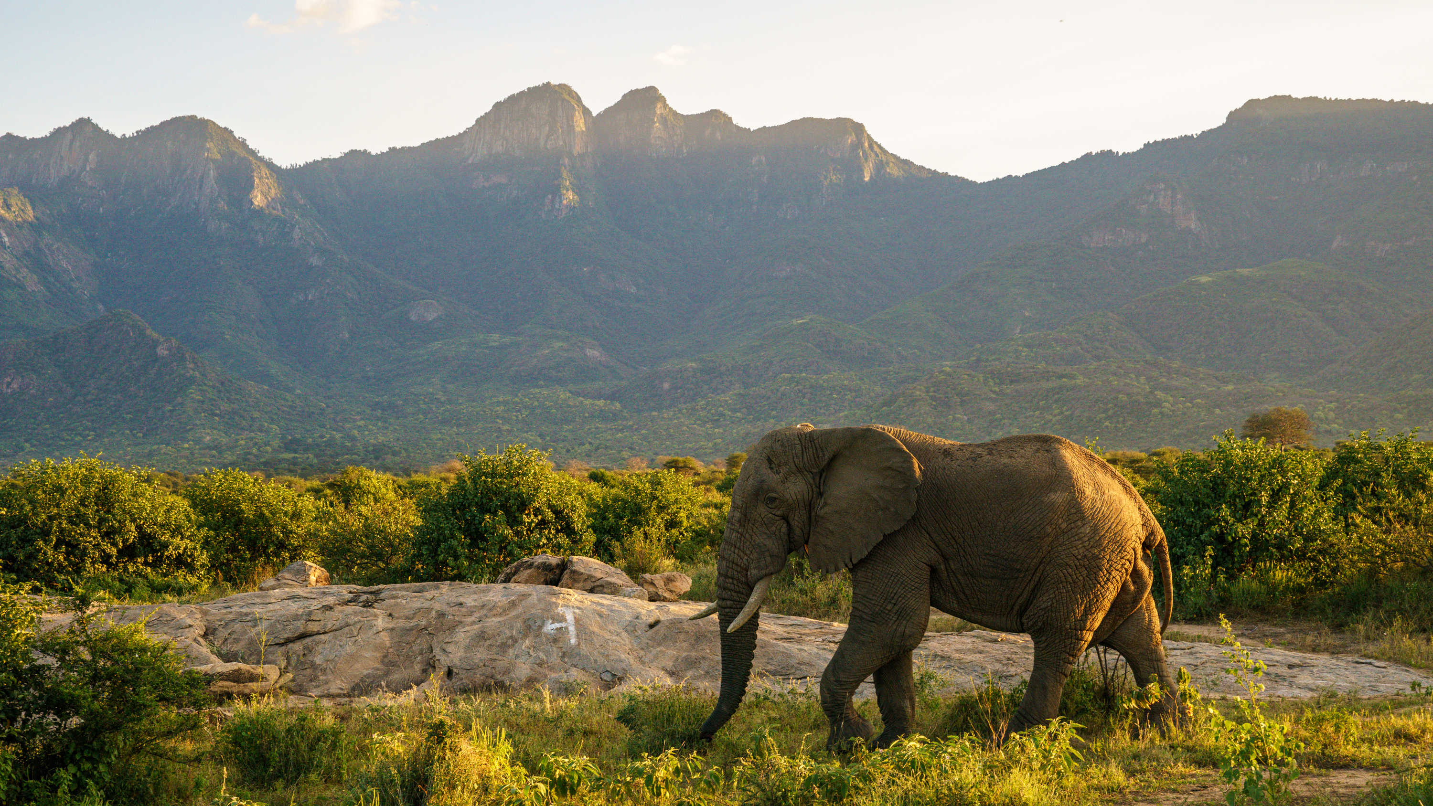
THANK YOU
©Jonathan Irish
14

Slide 15
Timeline for Proof of Concept: current/historic trends in costs and returns of NCS interventions
AUG
SEPT
OCT
NOV
DEC
Clean current data (i.e., GEF, NCS pipeline and hopefully AidData)
Contact folks for more data (GIZ, ZUG, FCDO, IADB, World Bank, USAID)
Continue to update data frame with incoming data and clean
Determine major predictors and outcomes for model
Provide Random Forest comparison for donors
Build simple models using fake data
Build simple models using real data
Build multivariate outcome model using fake data
Build multivariate outcome model using real data
& extract predictions for forecasts
Synthesize Results and Draft Proof of Concept
Start outline for Intro
Start outline for Methods
Start outline for Results and Conclusions

Slide 16
Timeline for Impact Forecasts: forecasting cost and returns of NCS interventions using POC model posteriors
JAN
FEB
MAR
APR
MAY
JUNE
Clean all data in repo (Possibly still integrating new data sources)
Submit POC to journal
Build POC model using all data
Using model posteriors, start to build model forecasts
Build multivariate outcome model for forecasts
Integrate models and data in Trends.Earth
Synthesize Results and submit draft to journal for forecasts
Start outline for Intro
Start outline for Methods
Start outline for Results and Conclusions

